Slide 1
Quadratics – Vertex Form
9MATH#9

Slide 2
Quadratics – Vertex Form
LEARNING INTENTIONS
Understand the format and the purpose of a Vertex Form of a Quadratic
Discover how to interchange between standard, intercept and vertex forms.
SUCCESS CRITERIA
Convert a quadratic equation from standard form to vertex form.
Use a vertex form quadratic to determine the coordinates of the vertex.

Slide 3
Previous lesson revisit…
Last lesson, we looked at converting a Quadratic from General Form:
y = ax² + bx + c
to Intercept Form:
y = a(x – p)(x – q)

Slide 4
…into todays lesson.
Last lesson, we looked at converting a Quadratic from General Form:
y = ax² + bx + c
to Intercept Form:
y = a(x – p)(x – q)
This less, we will be looking at converting a General Form Quadratic to Vertex Form:
y = a(x – h)² + k

Slide 5
Vertex Form Example → y = a(x – h)² + k
For this example, we will solve y = x² – 10x + 16

Slide 6


Vertex Form Example → y = a(x – h)² + k
For this example, we will solve y = x² – 10x + 16
Half the term of the x term (-10 -> -5)
Write this as (x-5)²
Subtract (-5)² from both sides
Combine the constant terms
$$y=x^{2}−10+16$$ $$y={\left(x−\frac{10}{2}\right)}^{2}−{\left(\frac{10}{2}\right)}^{2}+16$$ $$y={\left(x−5\right)}^{2}−25+16$$
$$y={\left(x−5\right)}^{2}−9$$

Slide 7
Vertex Form Example → y = a(x – h)² + k
For this example, we will solve y = x² – 10x + 16
Half the term of the x term (-10 -> -5)
Write this as (x-5)²
Subtract (-5)² from both sides
Combine the constant terms
$$y=x^{2}−10+16$$ $$y={\left(x−\frac{10}{2}\right)}^{2}−{\left(\frac{10}{2}\right)}^{2}+16$$ $$y={\left(x−5\right)}^{2}−25+16$$
THIS PROCESS IS REFERRED TO AS “COMPLETING THE SQUARE”
$$y={\left(x−5\right)}^{2}−9$$

Slide 8
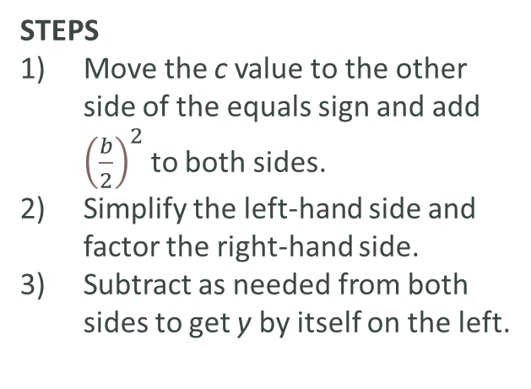
Vertex Form Example → y = a(x – h)² + k (WE DO)
CONVERT THE BELOW FROM STANDARD FORM INTO VERTEX FORM
x² – 4x + 8
x² + 6x + 11
x² + 14x + 50
x² – 2x + 3
x² + 18x + 77
x² + 4x - 5
STEPS
Move the c value to the other side of the equals sign and add ${\left(\frac{b}{2}\right)}^{2}$ to both sides.
Simplify the left-hand side and factor the right-hand side.
Subtract as needed from both sides to get y by itself on the left.

Slide 9
Vertex Form Example → y = a(x – h)² + k (WE DO)
CONVERT THE BELOW FROM STANDARD FORM INTO VERTEX FORM
x² – 4x + 8 => (x-2)² + 4
x² + 6x + 11 => (x+3)² + 2
x² + 14x + 50 => (x+7)² + 1
x² – 2x + 3 => (x-1)² + 2
x² + 18x + 77 => (x+9)² - 4
x² + 4x – 5 => (x+2)² - 9
STEPS
Move the c value to the other side of the equals sign and add ${\left(\frac{b}{2}\right)}^{2}$ to both sides.
Simplify the left-hand side and factor the right-hand side.
Subtract as needed from both sides to get y by itself on the left.

Slide 10
Purpose of the Vertex Form
If the General Form of a quadratic is where we start:
y = ax² + bx + c
And the Intercept Form of a quadratic is used to find the intercepts:
y = a(x – p)(x – q)
Then the Vertex Form is used to find the coordinates of the vertex:
y = a(x – h)² + k

Slide 11
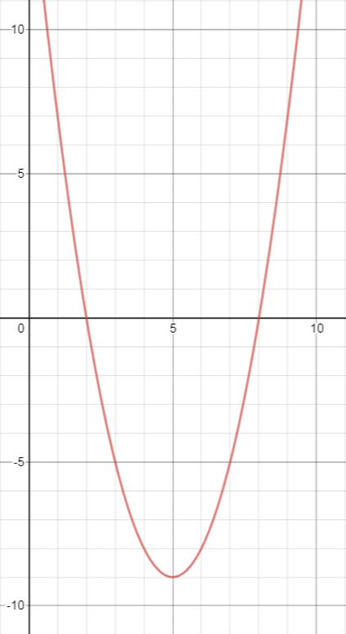
Vertex Form Quadratic:
Once you have completed the square and determined the Vertex Form, the hard work is done.

Slide 12
Vertex Form Quadratic → y = a(x – h)² + k
Once you have completed the square and determined the Vertex Form, the hard work is done.
This ‘tip’ of the quadratic curve is the vertex; like all points on the Cartesian Plane (x- & y-axis) it has an x-coordinate and a y-coordinate.
These coordinates are (h, k)

Slide 13
Vertex Form Quadratic → y = a(x – h)² + k
Once you have completed the square and determined the Vertex Form, the hard work is done.
This ‘tip’ of the quadratic curve is the vertex; like all points on the Cartesian Plane (x- & y-axis) it has an x-coordinate and a y-coordinate.
These coordinates are (-h, k)
So for our previous example of y = (x – 5)² – 9, the coordinates of the vertex should be:
(-(-5), -9) => (5, -9)

Slide 14
Vertex Form Example → y = a(x – h)² + k (WE DO)
FROM THE VERTEX FORMS BELOW, FIND THE COORDINATES OF THE VERTEX FORMS BELOW
x² – 4x + 8 => (x - 2)² + 4
x² + 6x + 11 => (x + 3)² + 2
x² + 14x + 50 => (x + 7)² + 1
x² – 2x + 3 => (x - 1)² + 2
x² + 18x + 77 => (x + 9)² - 4
x² + 4x – 5 => (x + 2)² - 9

Slide 15
Vertex Form Example → y = a(x – h)² + k (WE DO)
FROM THE VERTEX FORMS BELOW, FIND THE COORDINATES OF THE VERTEX FORMS BELOW
x² – 4x + 8 => (x - 2)² + 4 => (-(-2), 4) = (2,4)
x² + 6x + 11 => (x + 3)² + 2 => (-3, 2)
x² + 14x + 50 => (x + 7)² + 1 => (-7, 1)
x² – 2x + 3 => (x - 1)² + 2 => (-(-1), 2) = (1, 2)
x² + 18x + 77 => (x + 9)² – 4 => (-9, -4)
x² + 4x – 5 => (x + 2)² – 9 => (-2, -9)

Slide 16
Vertex Form Example → y = a(x – h)² + k (WE DO)
CONVERT THE BELOW FROM STANDARD FORM INTO VERTEX FORM
x² – 4x + 8
x² + 6x + 11
x² + 14x + 50
x² – 2x + 3
x² + 18x + 77
x² + 4x - 5
STEPS
Move the c value to the other side of the equals sign and add ${\left(\frac{b}{2}\right)}^{2}$ to both sides.
Simplify the left-hand side and factor the right-hand side.
Subtract as needed from both sides to get y by itself on the left.

Slide 17
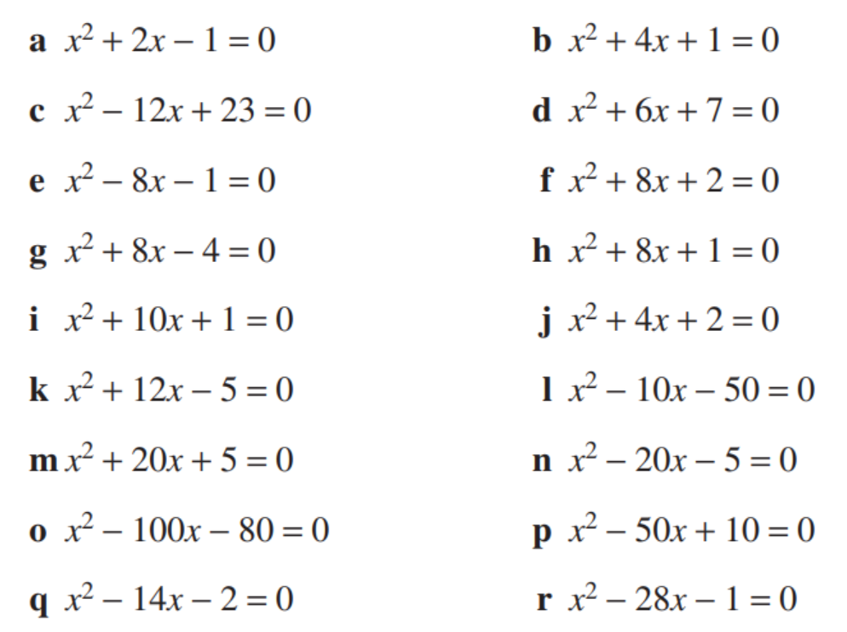
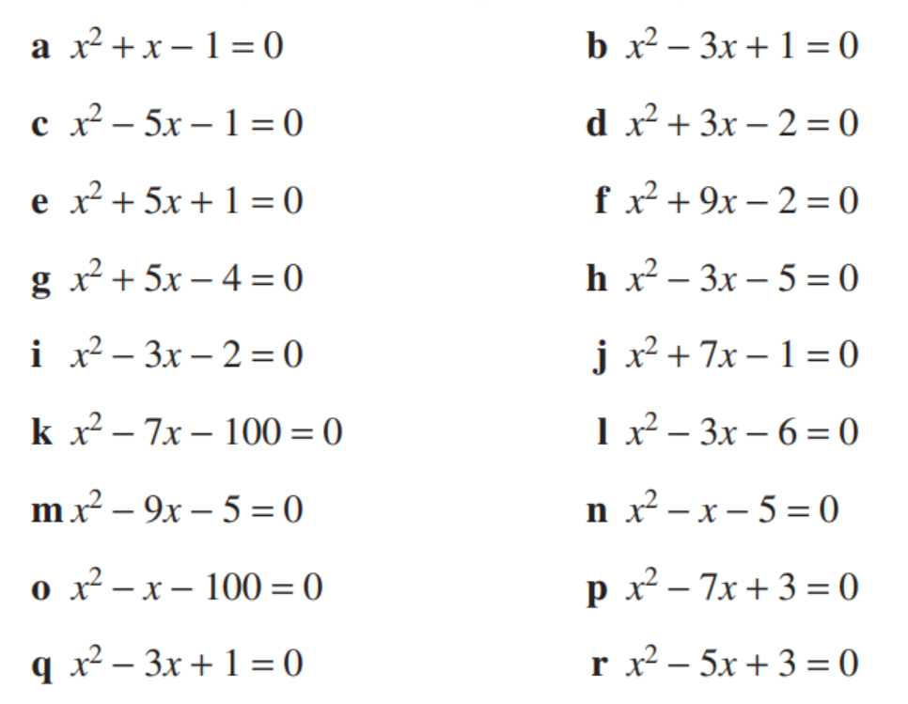
Complete the Square and then sketch the following:

